Slide 1
LAMP SOLAR Data calculator
Presented by: Team 2

Slide 2
The Agenda
Meet the Team
Our Stakeholders
Project LAMP Background
Project Goals
General Design & Methods Overview
Design
Demo
Summary

Slide 3
Meet the Team
Justin Au
Anna Hughes
Tanea Jenkins
Sang Kim
Tyler Newton

Slide 4
Our Stakeholders
Dr. Richard Watson, UGA Information Systems
Dr. Maric Boudreau, UGA Information Systems
Marc van Iersel , UGA Horticulture

Slide 5
Project LAMP Background
Department of Agriculture’s Virtual Grower
Our Customer
Project LAMP Forum

Slide 6
Project Goals
Quickly calculate the daily LED wattage requirement & cost of growing specific plants in designated zip codes
Utilize historical data from Athens with several types of popular crops
Design the calculator on a modular platform for future use and changes

Slide 7
General Design & Methods Overview
Utilizing Shiny from R-Studio to make the current R data and files into a modular web application
Integrating the current design into any format while outputting to HTML

Slide 8
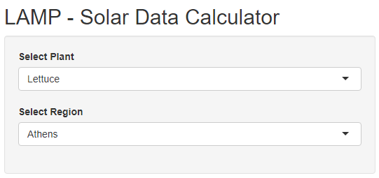
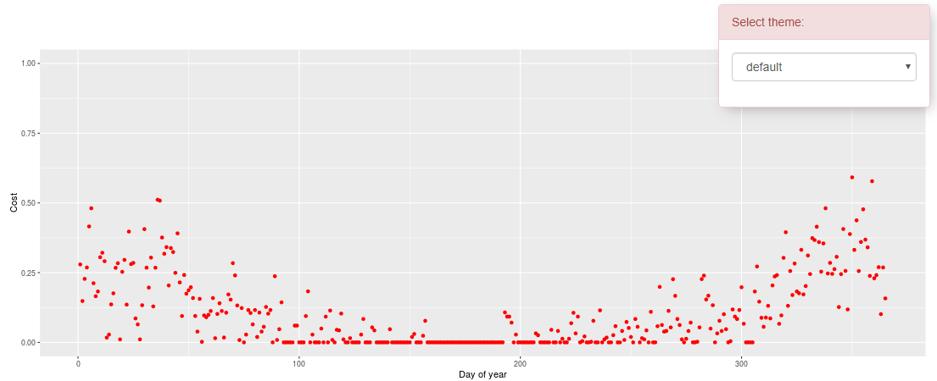
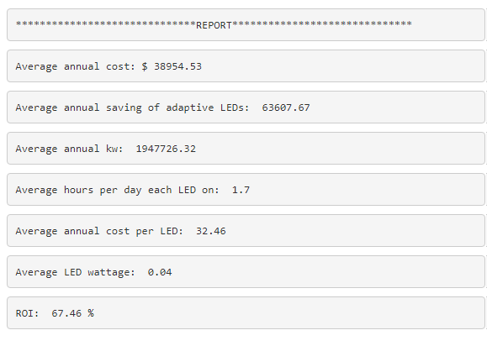
The Design

Slide 9
In Summary
Supported the Customer with Solar Data Calculator based on type of crop and location by zip code
Designed the calculator on a modular platform for future use and changes
Assisting UGA LAMP Forum and Department of Agriculture promote efficiency, conservation, and productivity
Stakeholder Handoff

